Slide 1

Case Study ON Top 1000 companies in the world
By
Pratik Dalvi

Slide 2
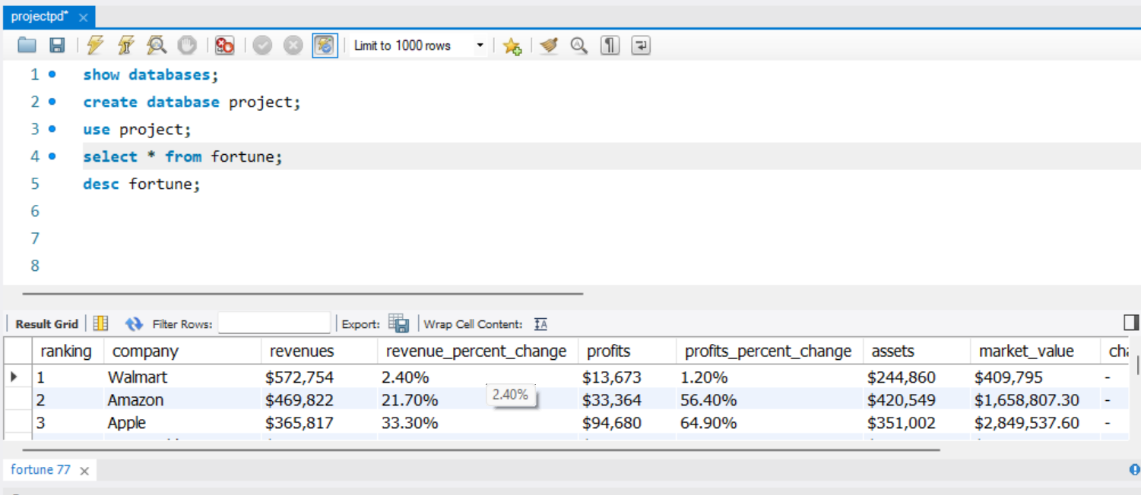
Importing Dataset In MySQL Workbench

Slide 3
Constraints:
NOT Null: NOT Null Constraint is used when we need a column that can not hold any null value.
Unique: The UNIQUE constraint ensures that all values in a column are different.
Default: The DEFAULT constraint is used to provide a default value for a column. The default value will be added to all new records IF no other value is specified.
Primary Key: The PRIMARY KEY is similar to UNIQUE Constraint but unlike UNIQUE Constraint there can be only one PRIMARY KEY for one table. The PRIMARY KEY column can not contain NULL values.

Slide 4
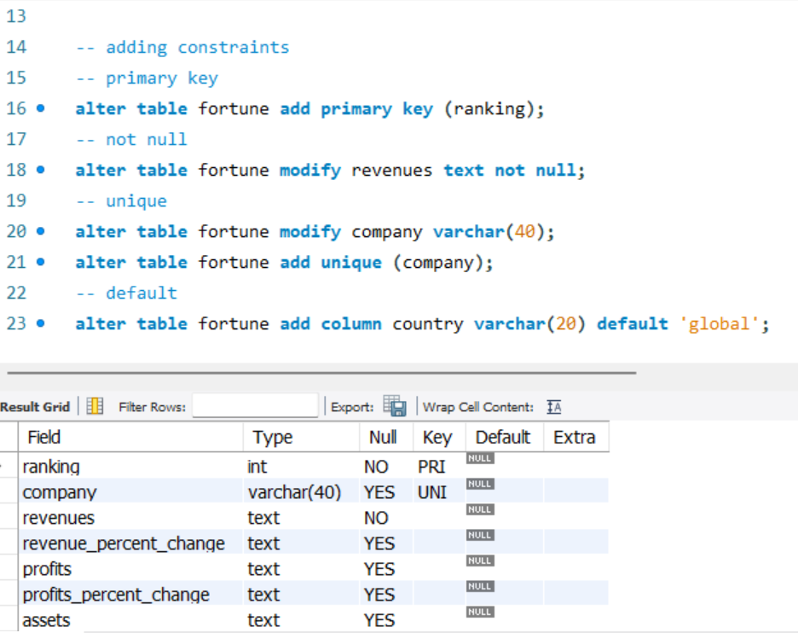
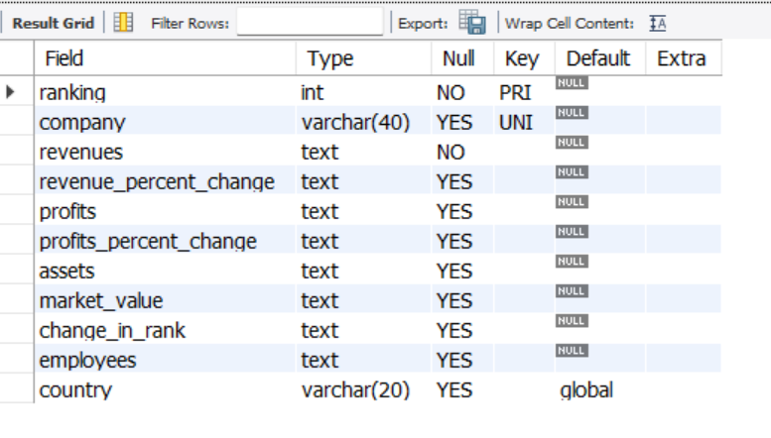
Constraints:

Slide 5
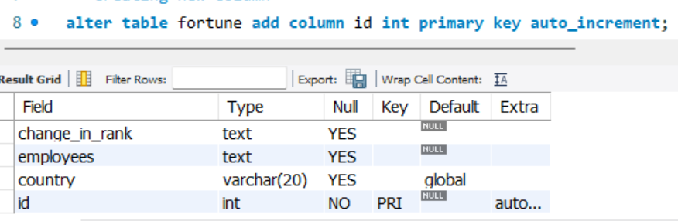
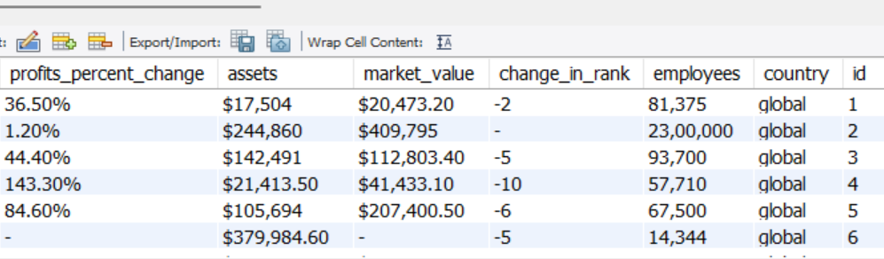
Auto Increment: AUTOINCREMENT is a keyword in SQL which is used to increment value of a field automatically while inserting new records in a table.

Slide 6
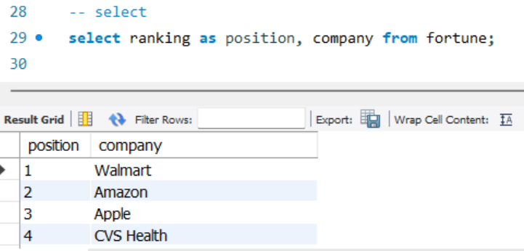
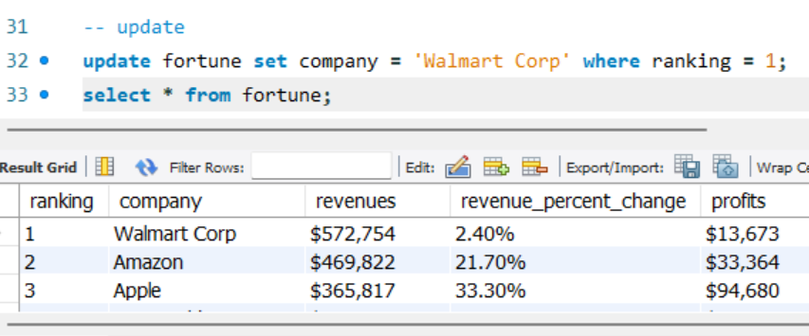
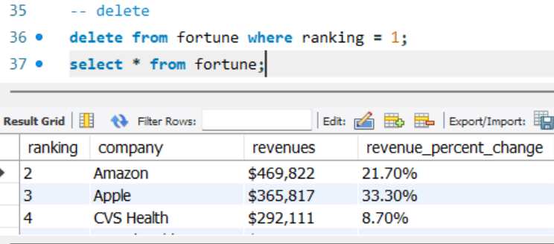
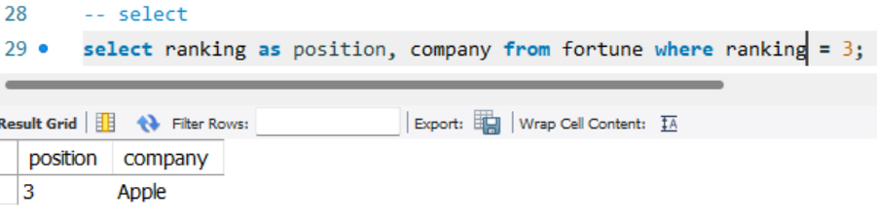
Where Clause: It filters the records. It returns only those queries which fulfill the specific conditions. WHERE clause is used in SELECT, UPDATE, DELETE statement etc.

Slide 7
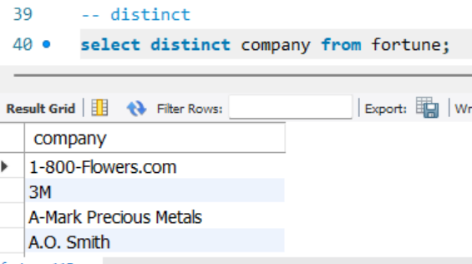
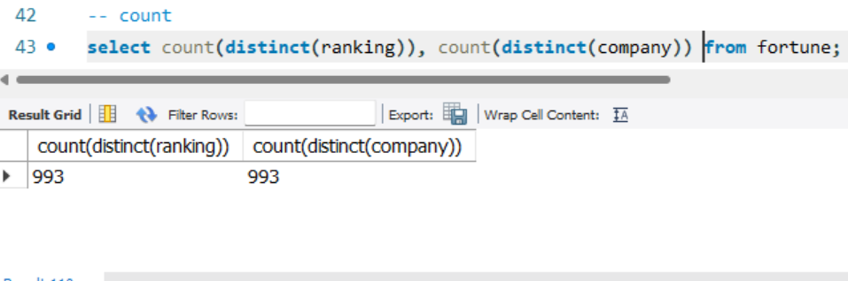
Count: It is used count number unique records present in the column.
Distinct: It is used fetch unique records from the column.

Slide 8
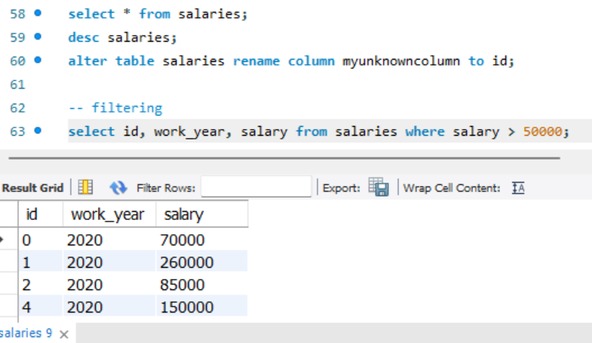
Filtering: It is used to filter data based on certain conditions.

Slide 9
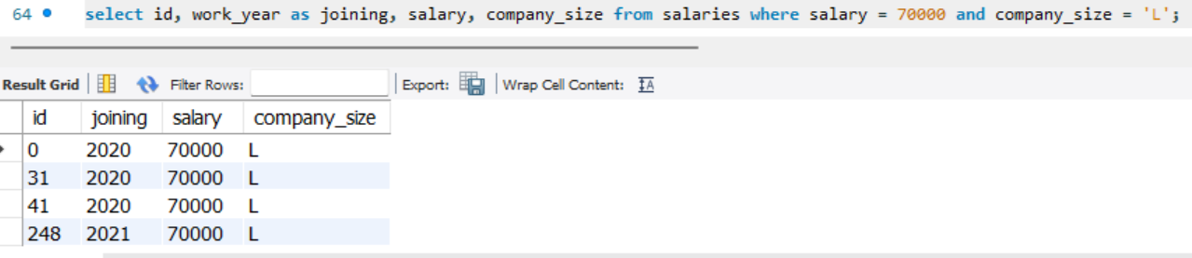
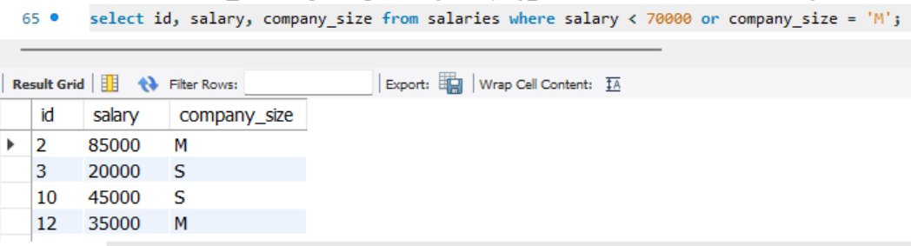
Filtering: We can use ‘and’, ‘or’, ‘between’ keywords

Slide 10
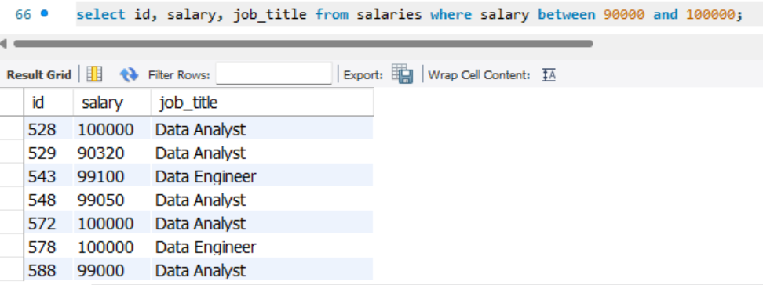
Filtering:

Slide 11
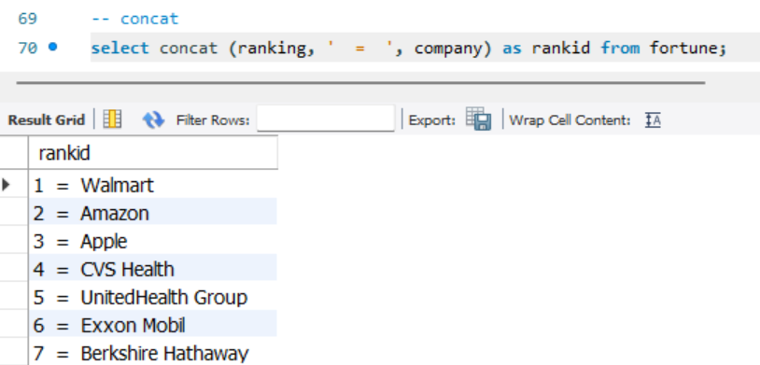
Concat: Concat is used to join two or more columns.

Slide 12
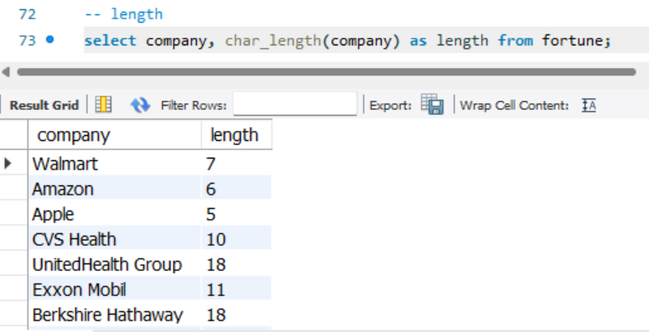
Length: Length is used to count length of specific sentence.

Slide 13
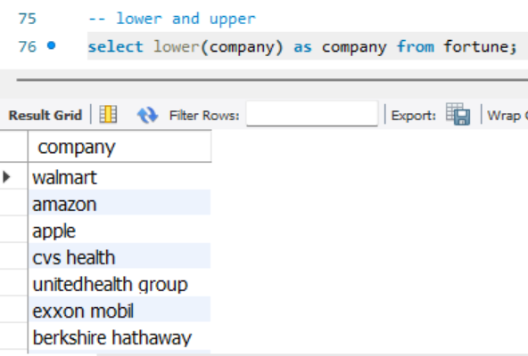
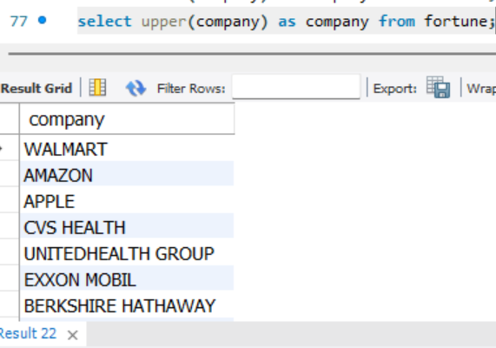
Lower is used to convert any string to lowercase and upper is used to convert any string to uppercase.

Slide 14
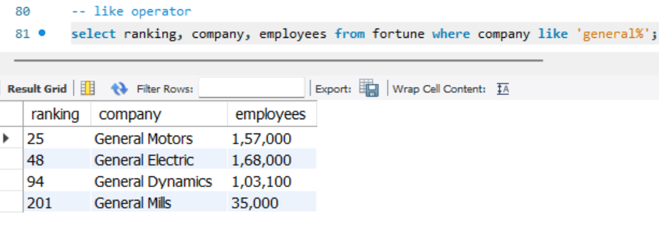
Like Operator: The LIKE operator used filtering wherein we know only a segment or a portion of the text.

Slide 15
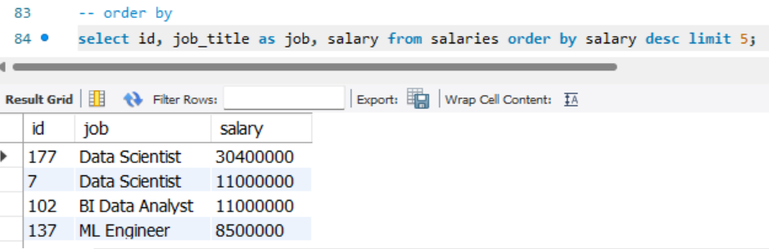
Order By: Order by is used for arrange data by ascending or descending order.

Slide 16
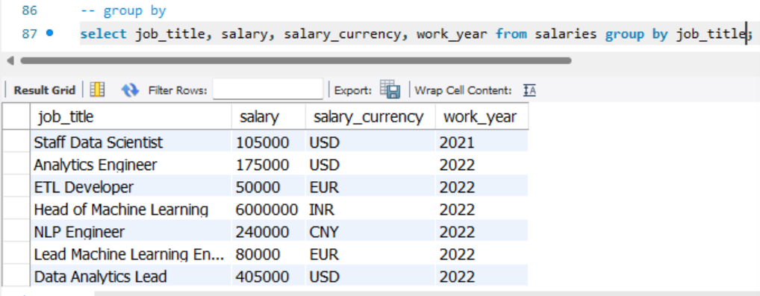
Group By:

Slide 17
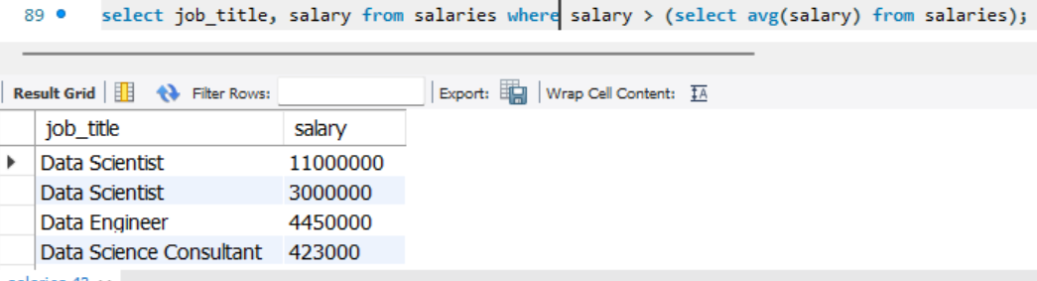
Sub Query:

Slide 18
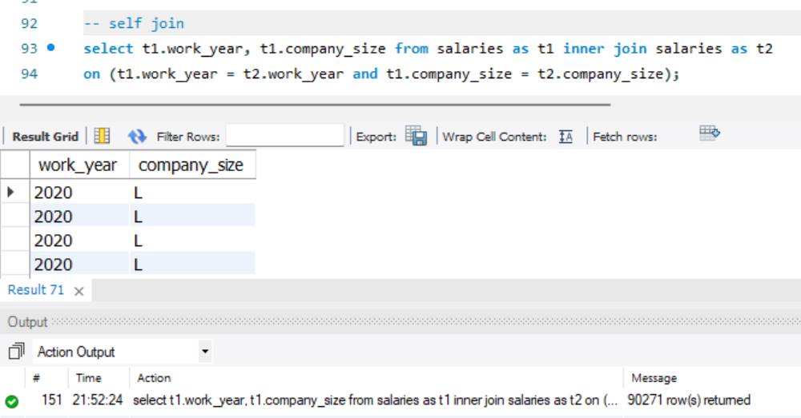
Self Join:

